Slide 1
Spotify Data Exploration: Three Insights into Musical Trends
Nikitha Chedudoopu
Sanketh Yelamanchili

Slide 2
Introduction to Dataset
The Spotify dataset consists of 160,000+ tracks from 1921-2020 found in Spotify as of June 2020.
Features include:
- id
- name
- artists
- duration_ms
- release_date
- year
- acousticness
- danceability
- energy
- instrumentalness
- liveness
- loudness
- speechiness
- tempo
- valence
- mode
- key
- popularity
- explicit
Notes:
id: A unique identifier for each track.
name: The track's title.
artists: Artist/s who participated in the track.
duration_ms: Length of the track in milliseconds (ms).
release_date: The track's release date in MM/DD/YYYY, or at the minimum, YYYY.
year: The year in which the track was released.
acousticness*: A confidence measure from 0.0 to 1.0 of whether the track is acoustic.
danceability*: Describes how suitable a track is for dancing. A value of 0.0 is least danceable and 1.0 is most danceable.
energy*: Energy is a measure from 0.0 to 1.0 and represents a perceptual measure of intensity and activity. Typically, energetic tracks feel fast and loud.
instrumentalness*: Predicts whether a track contains no vocals.
liveness*: Detects the presence of an audience in the recording.
loudness*: The overall loudness of a track in decibels (dB).
speechiness*: Detects the presence of spoken words in a track.
tempo*: The overall estimated tempo of a track in beats per minute (BPM).
valence*: A measure from 0.0 to 1.0 describing the musical positiveness conveyed by a track.
mode: Melodic content from the modality of a track. 1 = Major; 0 = Minor.
key: The estimated overall key of a track from the Pitch Class notation. E.g. 0 = C, 1 = C♯/D♭, 2 = D, and so on.
popularity: A track's popularity, 0-100 where 100 is the most popular based on Spotify's algorithm.
explicit: Whether or not the track has explicit lyrics. 1 = True; 0 = False.

Slide 3
EDA Objectives
Objective for EDA1 - Correlation Analysis:
Determine the relationships between musical features such as danceability, energy, and valence, and how they align with popularity and chart presence.
Objective for EDA2 - Evolution of Music Elements:
Track the progression of key musical elements over time, understanding how genres and listener preferences have evolved from 1921 to 2020.
Objective for EDA3 - Explicit Content Analysis:
Examine the prevalence of explicit content in songs across different eras to explore its correlation with cultural shifts and listener demographics.
Notes:
Our EDA aims to uncover the hidden patterns and trends within Spotify's extensive song dataset, revealing insights into the evolution of music consumption and production.
eda's are as follows.

Slide 4
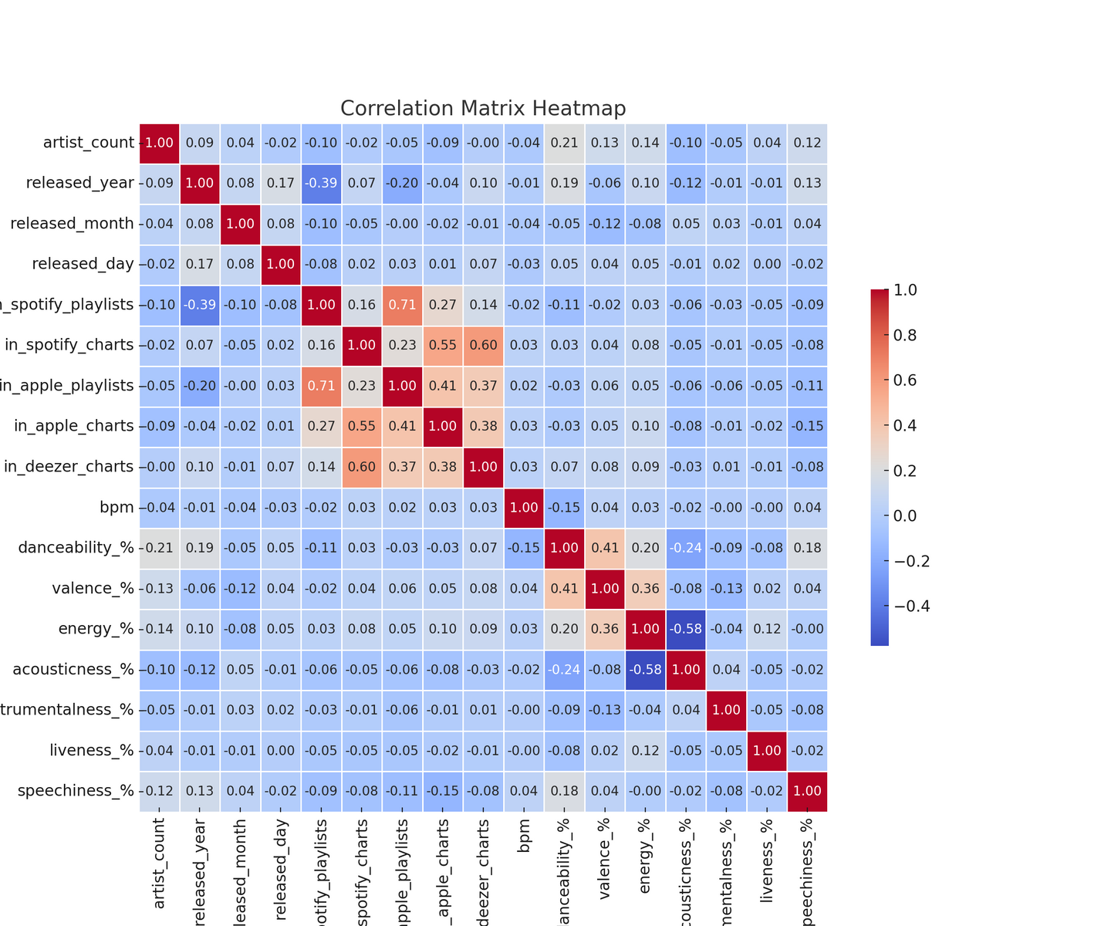
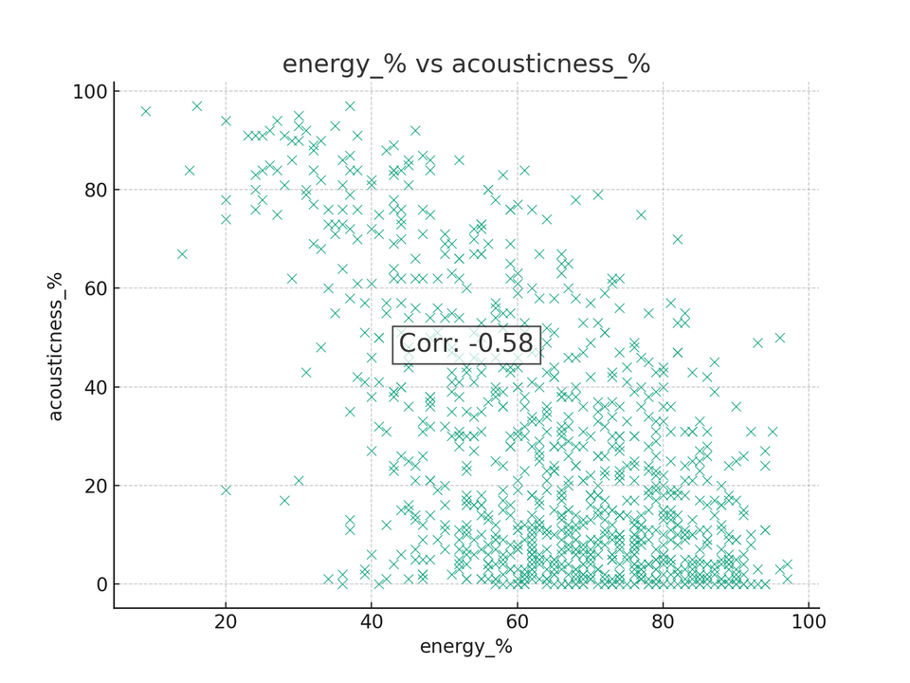
Correlation Analysis
Notes:
The image is a correlation matrix heatmap displaying the relationships between various musical attributes in a dataset of Spotify tracks. The matrix is organized as a grid where each cell represents the correlation between the variables denoted by the corresponding row and column. The variables include features such as 'artist count', 'released year', 'released month', 'released day', 'Spotify playlists inclusion', chart appearances ('in Spotify charts', 'in Apple charts', 'in Deezer charts'), and several musical elements like 'danceability', 'valence', 'energy', 'acousticness', 'instrumentalness', 'liveness', 'speechiness', and 'bpm' (beats per minute).
Energy_% and Acousticness_% (Correlation: -0.58):
*Explanation*: Energetic songs typically have lower acousticness, reflecting a preference for electronic over acoustic sounds in high-energy music.

Slide 5
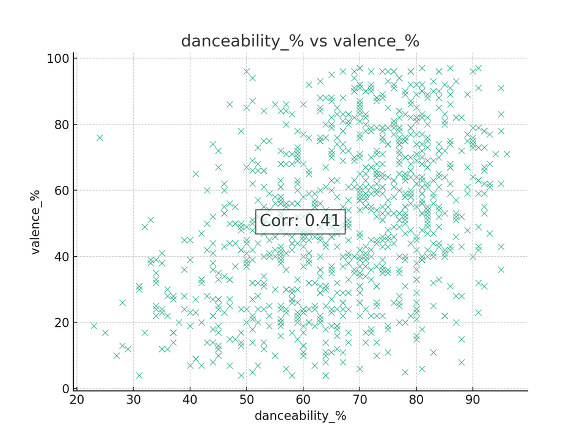
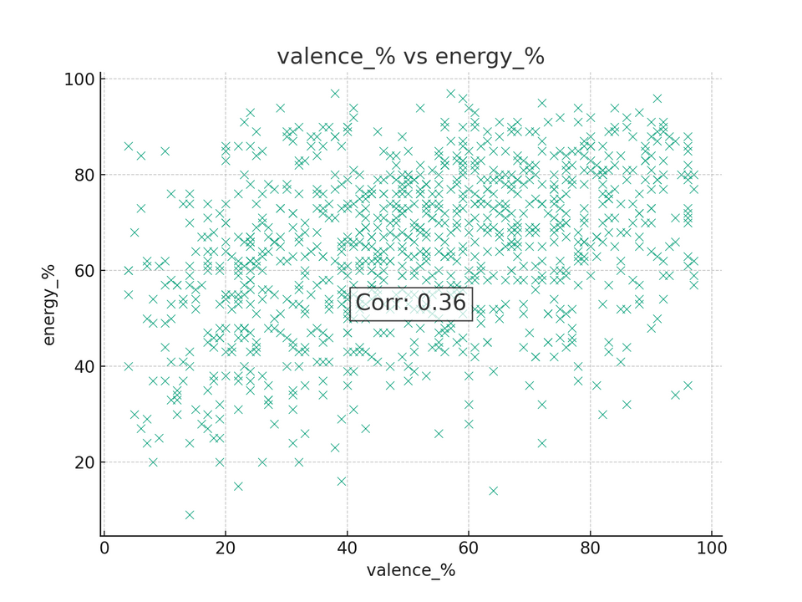
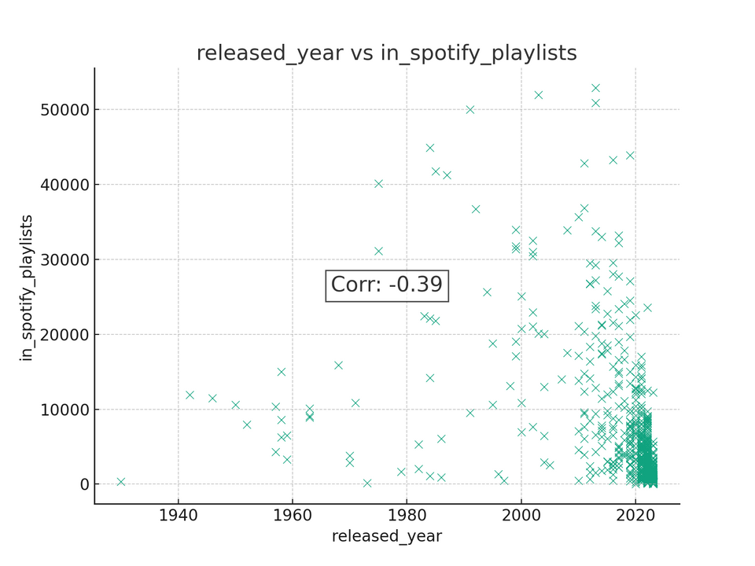
Notes:
Danceability_% and Valence_% (Correlation: 0.41):
*Explanation*: Danceable songs are usually more positive, aligning with dance music's upbeat and joyful characteristics.
Valence_% and Energy_% (Correlation: 0.36):
*Explanation*: Songs with higher valence often have higher energy, suggesting a link between positive mood and lively composition.
Released_Year and In_Spotify_Playlists (Correlation: -0.39):
*Explanation*: Newer songs are less common in Spotify playlists, possibly because older songs have had more time to be added to playlists.

Slide 6
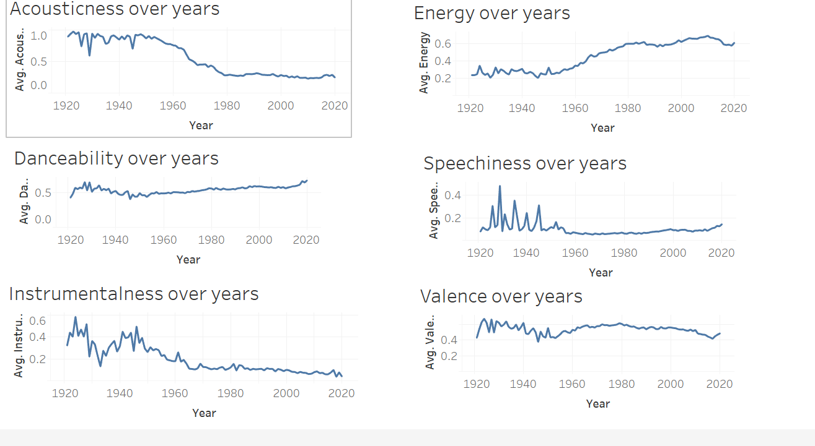
Evolution Of Music
Notes:
Quite a lot of graphs to unpack here, but let's run through them one by one and make some discoveries on the data.
First and foremost, we can see a dramatic decrease in the areas of acousticness and instrumentalness through the years. These could be attributed to the rise of electrical and electronic music in the mid-20th century. For both elements, we see a gradual decrease in the 50's, followed by a sharp fall beginning in the 60's – a decade of musical breakthroughs with the rise of synthesizers in music production and rock music. This adversely affected the energy element, which saw a drastic upward trend in about the same time. This is because higher energy levels are typically attributed to having traits of being fast and noisy, scoring high in genres such as death metal and electronic dance music (EDM).
As shown by how the trend for synthesized increased, the speechiness of the songs have decreased since the synthetic melody of advance technology have grown into trend.
danceability has sustained generally high levels in music through the years, however, there is a noticeable drop in the mid-40's to 50's. This was probably a side-effect of post-war modernism, where music gravitated upon a more somber, heroic tone to fit the mood of the wake of World War 2, the deadliest war in history.
Similar to danceability, valence, which is a measure of how positive (i.e. happy) a song is, likewise saw a sharp decrease in the post-war era. It saw an upward trend, particularly around the mid-50's to 70's that could have been because of the hippie music genre that had its moment as an opposing force of peace to the United States' involvement in the Vietnam War.

Slide 7
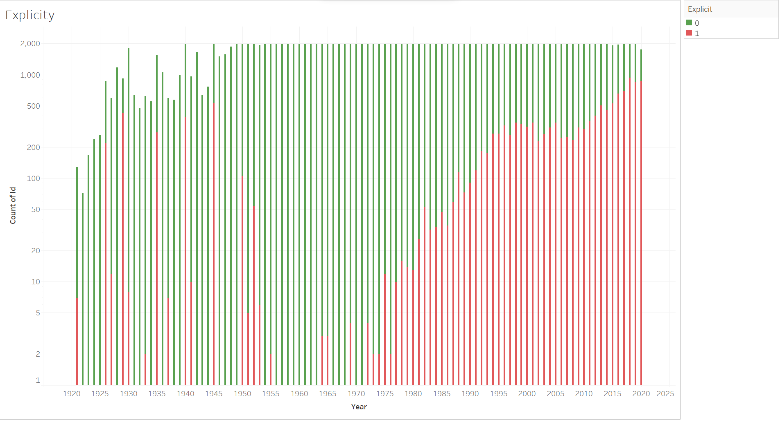
Explicit Content Analysis
Notes:
Based on the tabulated data, the presence of explicit songs can be seen as consistent and steadily increasing since the beginning of the 80's. This could be because of the advent of Hip-Hop music that started in the Bronx, New York City in the late 70's. Being one of the more controversial yet artistic genres for its liberal expression, Hip-Hop has garnered its fair share of criticisms due to its explicit mentions of drugs, vices, and sex.
Going back to the data, the notable outlier years are 1926, 1929, 1935, 1940, and 1945, being the lone years that have reached > 100 explicit tracks before the Hip-Hop era. The researchers have found that the genre of dirty blues rose around those times, being earlier documents of predominantly male artists singing sexually suggestive lyrics. It is because of this that some musical experts have tagged the 1930's as one of the dirtiest music eras.

Slide 8
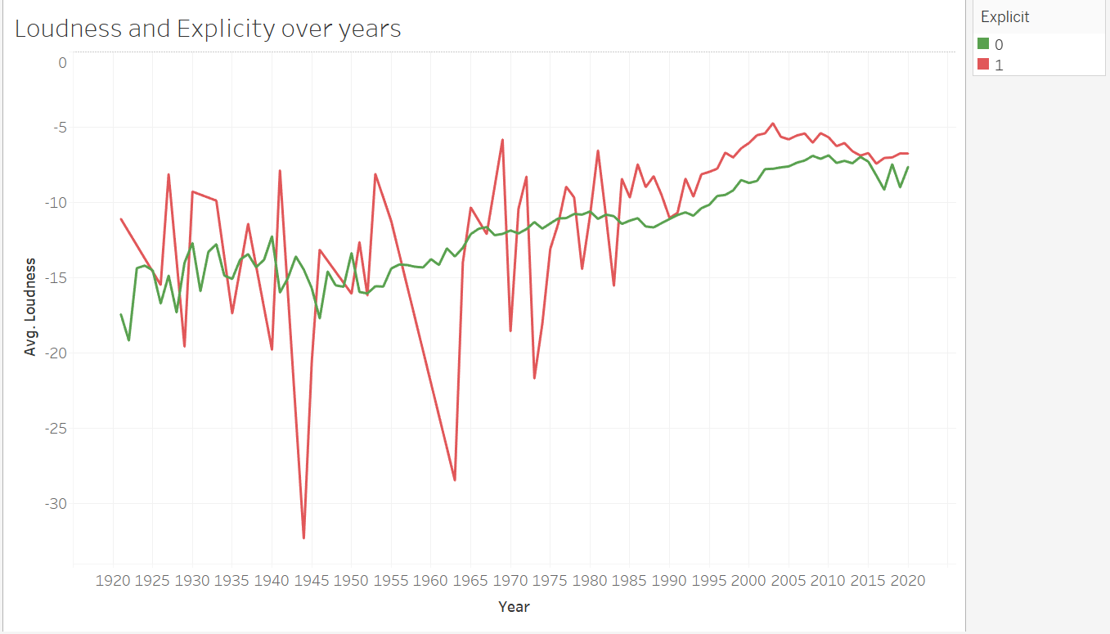
Notes:
The graph showcases trends in the loudness and explicitness of songs over the years. The data indicates an overall increase in the average loudness of tracks on Spotify, with explicit songs (marked in red) generally exhibiting higher loudness levels than non-explicit ones (marked in green). Additionally, there seems to be a rise in the number of songs with explicit lyrics over time. This suggests that modern music is not only becoming louder but also contains more explicit content, reflecting a possible shift towards more intense and expressive lyrical themes in the industry.

Slide 9
Concluding Insights
Louder Over Time:
Songs have consistently become louder.
More Explicit Lyrics:
There's been a rise in songs labeled as explicit.
Fewer Instruments:
Use of instruments in songs has dropped significantly.
Songs Made for Dancing:
Songs have become more dance-friendly.
Shorter Song Lengths:
Recent years have seen a trend toward shorter tracks.
What Makes a Hit:
Energetic, loud, and danceable tracks tend to be more popular, while songs with more instruments and less electronic production are less common on the charts.
Notes:
*read from the slide*
ending para:
As we've seen, the sound of music is changing. It's louder, more direct, and gets us on our feet. The tracks are shorter, perhaps reflecting our shorter attention spans in the digital age. And when it comes to popularity, it's the vibrant, energetic tunes that capture our hearts. This isn't just data – it's the soundtrack of our evolving culture

